Slide 1

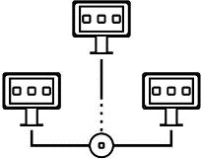



Introduction to
Parallel and Distributed Programming
CS3
Introduction to MPI
Sachin D N

Slide 2
Agenda
Setting up a cluster of VMs
Message Passing Interface
Blocking / Non-blocking messages
Data partitioning
Lab2: Parallel and distributed data processing

Slide 3
Lab 2: Use cluster to distribute work and do some
parallel data processing
Now that you have a group of nodes managed as a cluster
Create a distributed data processing capability.
Master node takes a dataset and distributes / partitions the data on multiple active slaves that have
enough resources.
Slaves process the data and send results back to Master. Master merges / reduces the data and reports back to the user.
Use blocking vs non-blocking messages in OpenMPI.
Status of the work at slaves is reported back to the master as work progresses and finishes.
Master collects the performance data (CPU, mem, IO) and stores it for analysis.
Any errors are also reported to the master.
Use compression to transfer data. Quantify communication cost - bytes sent over the network,
latency of transfer.
Use OpenMPI for communication between nodes, zlib etc. compression libs
Handle a node crash - Master should get work done on remaining nodes. What are the options - should it restart the job or only shift part of the work to another node ? How is a slave crash detected
? Use the heartbeat mechanism.

Slide 4
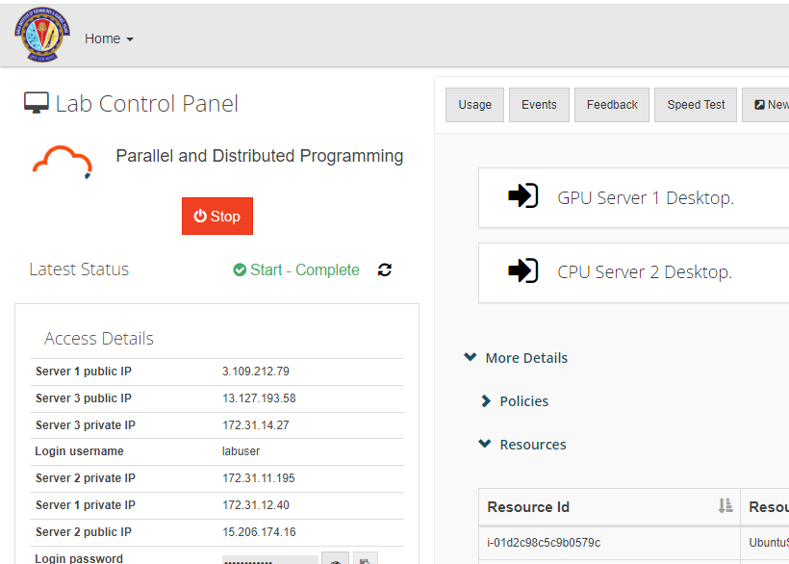
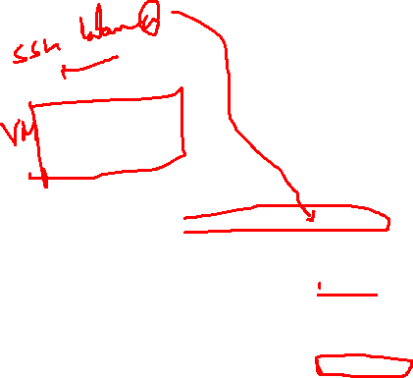
Setting up a cluster of VMs (MPI Cluster)
Step 1: Configure your hosts file
hosts file is used by the device operating system to map hostnames to IP addresses.
Example of a host file in master.
$ sudo nano /etc/hosts #MPI CLUSTERS
172.20.36.120 manager
172.20.36.153 worker1
172.20.36.143 worker2
172.20.36.116 worker3
For worker (slave) node
Example of a host file for worker2
#MPI CLUSTER SETUP
172.20.36.120 manager
172.20.36.143 worker2
$ mpirun -hostfile /etc/hosts ./mpi_hello

Slide 5
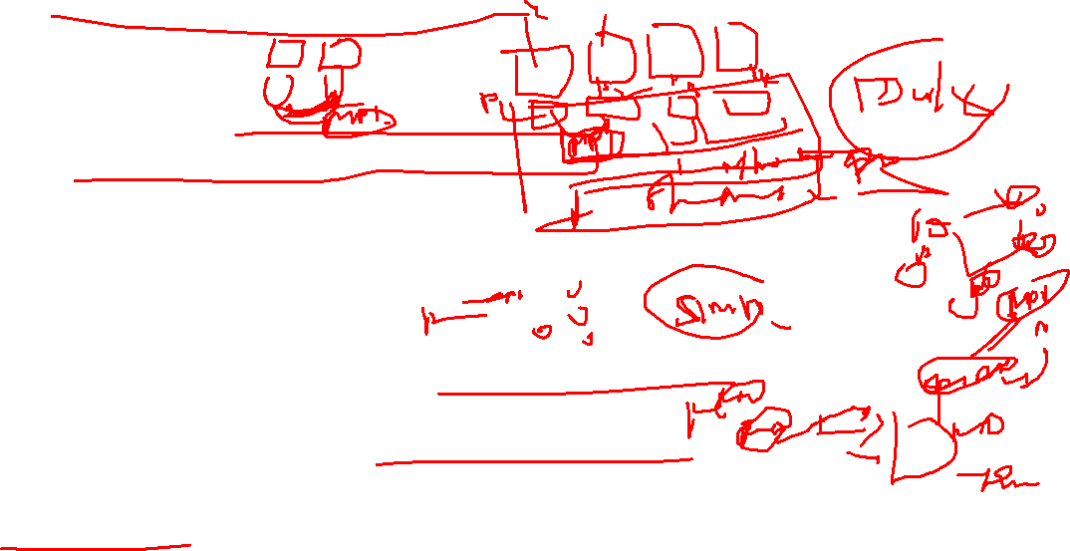
MPI (Message Passing Interface)
A standard message passing specification for the vendors to implement
Context: distributed memory parallel computers
Each processor has its own memory and cannot access the memory of other processors
Any data to be shared must be explicitly transmitted from one to another
Most message passing programs use the single program multiple data (SPMD) model
Each processor executes the same set of instructions
Parallelization is achieved by letting each processor operation a different piece of data
MIMD (Multiple Instructions Multiple Data)
https://github.com/schuang/mpi-tutorial

Slide 6
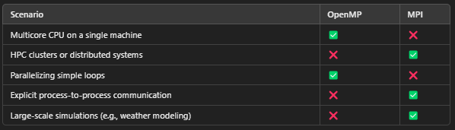
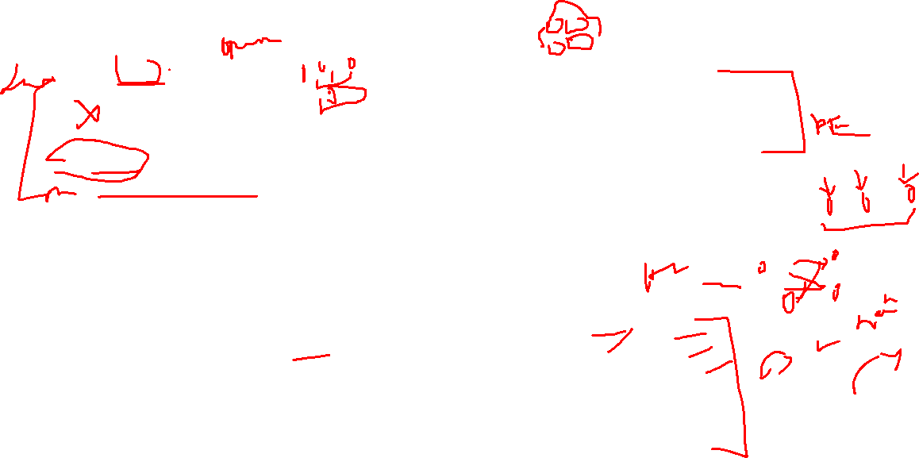
Parallelism Model
OpenMP (omp.h):
Shared Memory Model: OpenMP is designed for parallelism on shared-memory architectures, such as a single multicore machine.
Threads run in the same memory space and communicate implicitly by reading and writing to shared variables.
Example: Parallelizing loops in a single program running on one node with multiple CPU cores.
MPI (mpi.h):
Distributed Memory Model: MPI is designed for parallelism on distributed-memory systems, where multiple machines (nodes) communicate with each other over a network.
Each process has its own memory space, and processes communicate explicitly by sending and receiving messages.
Example: Running a program across a cluster of machines where each node has its own memory.

Slide 7

Why MPI?
Small
Many programs can be written with only 6 basic functions
Large
MPI’s extensive functionality from many functions
Scalable
Point-to-point communication
Flexible
Don’t need to rewrite parallel programs across platforms
MPI_INIT : Initiate an MPI computation.
MPI_FINALIZE : Terminate a computation. MPI_COMM_SIZE : Determine number of processes. MPI_COMM_RANK : Determine my process identifier. MPI_SEND : Send a message.
MPI_RECV : Receive a message.

Slide 8












What we need to know…
How many people are working?
What is my role?
How to send and receive data?

Slide 9

Basic functions
Function | Description
int MPI_Init(int *argc, char **argv) | Initialize MPI
int MPI_Finalize() | Exit MPI
int MPI_Comm_size(MPI_Comm comm, int *size) | Determine number of processes within a comm
int MPI_Comm_rank(MPI_Comm comm, int *rank) | Determine process rank within a comm
int MPI_Send(void *buf, int count, MPI_Datatype datatype, int dest, int tag, MPI_Comm comm) | Send a message
int MPI_Recv(void *buf, int count, MPI_Datatype datatype, int src, int tag, MPI_Comm comm, MPI_Status *status) | Receive a message
https://github.com/sachugowda/pds-bits/blob/main/run-allfunmpi.md

Slide 10
Basic functions
int MPI_Init(int *argc, char **argv)
Purpose: Initializes the MPI execution environment.
Explanation: This function must be called before any other MPI function. It prepares the runtime environment for communication among processes.
Usage: Typically used at the beginning of the MPI program to initialize arguments and communication settings.
2. int MPI_Finalize()
Purpose: Cleans up the MPI environment and terminates MPI.
Explanation: This function is called at the end of an MPI program to deallocate resources and gracefully exit the parallel environment.
Usage: Ensures that all MPI processes complete their tasks and exit cleanly.

Slide 11
Basic functions
3. int MPI_Comm_size(MPI_Comm comm, int *size)
Purpose: Determines the total number of processes in the specified communicator.
Explanation: This function returns the total number of processes (or nodes) participating in the MPI program.
Usage: Used to know how many processes are available for a given MPI communicator (e.g., MPI_COMM_WORLD).
int MPI_Comm_rank(MPI_Comm comm, int *rank)
Purpose: Determines the rank (ID) of the calling process within the specified communicator.
Explanation: Each process in an MPI program is assigned a unique rank (ID) ranging from 0 to size-1. This function retrieves that rank.
Usage: Allows processes to identify themselves and perform rank-specific tasks.

Slide 12
Basic functions
int MPI_Send(void *buf, int count, MPI_Datatype datatype, int dest, int tag, MPI_Comm comm)
Purpose: Sends a message from one process to another.
Explanation: This is a point-to-point communication function where:
buf: The data buffer to be sent.
count: Number of data elements to send.
datatype: Type of data being sent (e.g., MPI_INT, MPI_FLOAT).
dest: Rank of the destination process.
tag: Message identifier (used to differentiate between messages).
comm: Communicator in which communication occurs (e.g., MPI_COMM_WORLD).
Usage: Used to transmit data between processes in a specific communicator.
. int MPI_Recv(void *buf, int count, MPI_Datatype datatype, int src, int tag, MPI_Comm comm, MPI_Status *status)
Purpose: Receives a message sent by another process.
Explanation: This is a point-to-point communication function where:
buf: The data buffer to store the received message.
count: Maximum number of data elements to receive.
datatype: Type of data being received.
src: Rank of the source process.
tag: Message identifier (must match the tag used in MPI_Send).
comm: Communicator in which communication occurs.
status: Contains information about the received message (e.g., source, tag, etc.).
Usage: Used to retrieve data sent by another process in a specific communicator.

Slide 13
Communicator
An identifier associated with a group of processes
Each process has a unique rank within a specific communicator from 0 to (nprocesses-1)
Always required when initiating a communication by calling an MPI function
Default: MPI_COMM_WORLD
Contains all processes
Several communicators can co-exist
A process can belong to different communicators at the same time

Slide 14
Hello World
#include "mpi.h”
int main( int argc, char *argv[] ) {
int nproc, rank;
MPI_Init (&argc,&argv); /* Initialize MPI */
MPI_Comm_size(MPI_COMM_WORLD,&nproc); /* Get Comm Size*/ MPI_Comm_rank(MPI_COMM_WORLD,&rank); /* Get rank */
printf(“Hello World from process %d\n”, rank);
MPI_Finalize(); /* Finalize */ return 0;
}
https://github.com/sachugowda/pds-bits/blob/main/run-simplempi.md

Slide 15
How to compile…
Need to tell the compiler where to find the MPI include files and how to link to the MPI libraries.
Fortunately, most MPI implementations come with scripts that take care of these issues:
mpicc mpi_code.c –o a.out
Two widely used (and free) MPI implementations
MPICH (http://www-unix.mcs.anl.gov/mpi/mpich)
MPI Forum (https://www.mpi-forum.org/)
OPENMPI (http://www.openmpi.org)

Slide 16
Blocking Message Passing
A blocking send is a communication operation where the sender process waits until the data is either copied to a buffer or received by the destination process. The function only returns when the send operation is completed.
Characteristics:
Synchronous: The sender waits until the message is fully sent or buffered.
Guarantees Completion: The data is safe to modify only after the function returns.
Simple to Implement: Easier to use in programs because the operation is straightforward.
Can Cause Deadlocks: If not carefully implemented, blocking sends and receives can lead to deadlocks when both processes wait for each other.
https://github.com/sachugowda/pds-bits/blob/main/block-nonblock.md

Slide 17
Blocking Message Send
MPI_Send (void *buf, int count, MPI_Datatype dtype, int dest, int tag, MPI_Comm comm);
buf (Buffer):
Pointer to the data to be sent.
Example: &data if data is an integer.
count (Number of Elements):
Number of elements in the buffer to send.
Example: 1 for sending one integer.
dtype (Data Type):
Data type of the buffer elements (e.g., MPI_INT, MPI_FLOAT).
Example: Use MPI_INT for integers.
dest (Destination Rank):
Rank of the process to which the message is being sent.
Example: If you are sending data to process 1, set dest = 1.
tag (Message Tag):
An identifier for the message, used to distinguish between different types of messages.
Example: 0 for a generic tag.
comm (Communicator):
Communicator that defines the group of processes involved (usually MPI_COMM_WORLD).

Slide 18
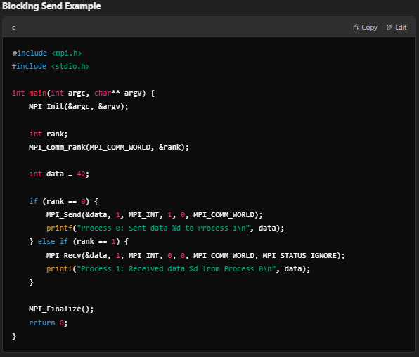
Blocking Message Examples

Slide 19
Non-blocking Message Passing
Non-Blocking Message Send
A non-blocking send allows the sender to proceed with its computation immediately after initiating the send. The operation completes asynchronously, meaning the function returns immediately after the communication is initiated, even if the message hasn’t been sent.
Characteristics:
Asynchronous: The sender does not wait for the message to be sent or received.
Requires Completion Check: The programmer must explicitly check if the send operation is complete (using MPI_Wait or MPI_Test).
Efficient for Overlap: Allows computation and communication to overlap, improving performance.
More Complex: Requires careful management to ensure data integrity.

Slide 20
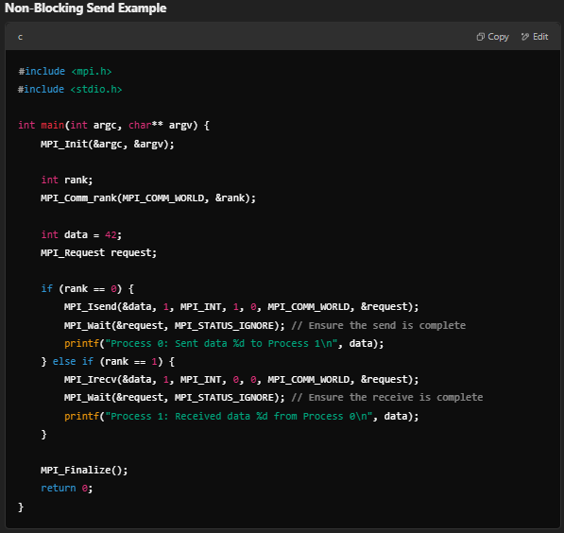
Non-blocking Message Passing

Slide 21
Non-blocking Message Passing
Aspect | Blocking Send (MPI_Send) | Non-Blocking Send (MPI_Isend)
Waiting Behavior | Waits until the operation completes. | Returns immediately after initiation.
Overlapping Tasks | No overlap of communication and computation. | Overlaps communication with computation.
Complexity | Simple to use. | Requires careful management of completion.
Risk of Deadlocks | Higher risk if poorly implemented. | Lower risk of deadlocks.
Performance | May introduce unnecessary delays. | Improves performance in large-scale applications.
https://github.com/sachugowda/pds-bits/blob/main/block-nonblock.md

Slide 22
Collective communications
A single call handles the communication between all the processes in a communicator
There are 3 types of collective communications
Data movement (e.g. MPI_Bcast)
Reduction (e.g. MPI_Reduce)
Synchronization (e.g. MPI_Barrier)

Slide 23



Broadcast
int MPI_Bcast(void *buffer, int count, MPI_Datatype datatype, int root, MPI_Comm comm);
One process (root) sends data to all the other processes in the same
communicator
Must be called by all the processes with the same arguments
P1 P2 P3 P4
P1 P2 P3 P4
A | B | C | D
A | B | C | D
A | B | C | D
MPI_Bcast
A | B | C | D
A | B | C | D

Slide 24



Gather
int MPI_Gather(void *sendbuf, int sendcnt, MPI_Datatype sendtype, void *recvbuf, int recvcnt, MPI_Datatype recvtype, int
root, MPI_Comm comm)
One process (root) collects data to all the other processes in the same communicator
Must be called by all the processes with the same arguments
P1 P2 P3
P1 P2 P3
A
A | B | C | D
B
MPI_Gather
C
P4
D
P4

Slide 25

Gather to All
int MPI_Allgather(void *sendbuf, int sendcnt, MPI_Datatype sendtype, void
*recvbuf, int recvcnt, MPI_Datatype recvtype, MPI_Comm comm)
All the processes collects data to all the other processes in the same communicator
Must be called by all the processes with the same arguments
P1 P2 P3
P1 P2 P3
A
A | B | C | D
B
A | B | C | D
MPI_Allgather
C
A | B | C | D
P4
D
P4
A | B | C | D

Slide 26


Reduction
int MPI_Reduce(void *sendbuf, void *recvbuf, int count, MPI_Datatype datatype, MPI_Op op, int root, MPI_Comm comm)
One process (root) collects data to all the other processes in the same communicator, and performs an operation on the data
MPI_SUM, MPI_MIN, MPI_MAX, MPI_PROD, logical AND, OR, XOR, and a few more
MPI_Op_create(): User defined operator
P1 P2 P3
P1 P2 P3
A | … | … | …
A+B+C+D
B | … | … | …
MPI_Reduce
C | … | … | …
P4
D | … | … | …
P4

Slide 27
Reduction to All
int MPI_Allreduce(void *sendbuf, void *recvbuf, int count, MPI_Datatype datatype, MPI_Op op, MPI_Comm comm)
All the processes collect data to all the other processes in the same communicator, and perform an operation on the data
MPI_SUM, MPI_MIN, MPI_MAX, MPI_PROD, logical AND, OR, XOR, and a few more
MPI_Op_create(): User defined operator
P1 P2 P3
P1 P2 P3
A | … | … | …
A+B+C+D
B | … | … | …
A+B+C+D
MPI_Reduce
C | … | … | …
A+B+C+D
P4
D | … | … | …
P4
A+B+C+D

Slide 28
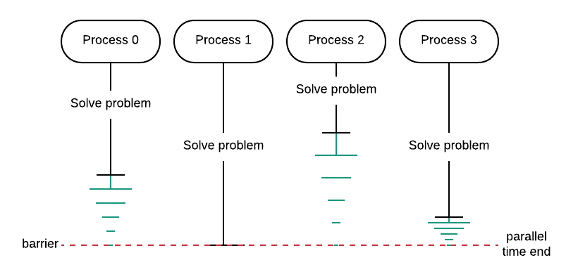
Synchronization
MPI_Barrier
Blocks until all processes in the communicator have reached this routine.
A barrier is used when you want all the processes to complete a portion of code before continuing.
int MPI_Barrier(MPI_Comm comm)
Reference : http://selkie.macalester.edu/csinparallel/modules/Patternlets/build/html/MessagePassing/Barrier_Tags.html

Slide 29
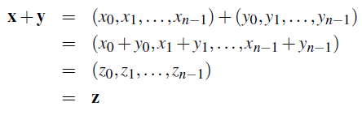
Data distributions
Compute a vector sum.

Slide 30
Context in Parallel Computing
This computation is often distributed across multiple processes to improve performance, especially for large vectors:
Data Distribution:
Each process works on a subset of the vectors x\mathbf{x}x and y\mathbf{y}y.
For example:
Process 0 computes z0=x0+y0z_0 = x_0 + y_0z0​=x0​+y0​, z1=x1+y1z_1 = x_1 + y_1z1​=x1​+y1​.
Process 1 computes z2=x2+y2z_2 = x_2 + y_2z2​=x2​+y2​, z3=x3+y3z_3 = x_3 + y_3z3​=x3​+y3​.
Parallel Efficiency:
By dividing the workload, each process handles fewer elements, speeding up the overall computation.
After all processes compute their part of z\mathbf{z}z, the results are combined.
MPI Example: Using MPI, the vectors x\mathbf{x}x and y\mathbf{y}y can be distributed among processes using functions like MPI_Scatter, and the results can be gathered using MPI_Gather.

Slide 31
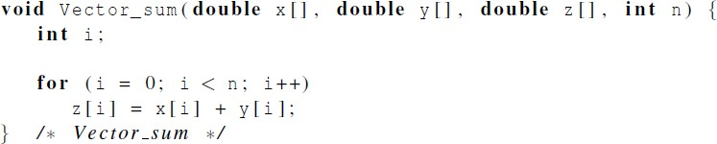
Serial implementation of vector addition

Slide 32
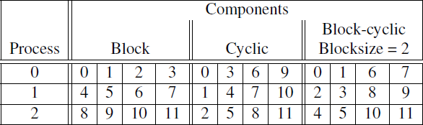
Different partitions of a 12-component vector among 3
processes

Slide 33
Partitioning options
Block partitioning
Assign blocks of consecutive components to each process.
Cyclic partitioning
Assign components in a round robin fashion.
Block-cyclic partitioning
Use a cyclic distribution of blocks of components.

Slide 34
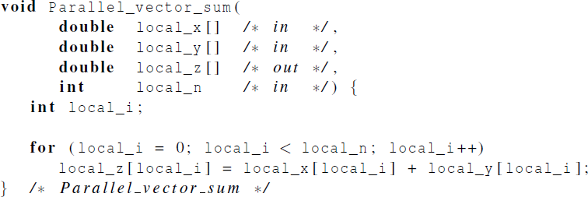
Parallel implementation of vector addition

Slide 35
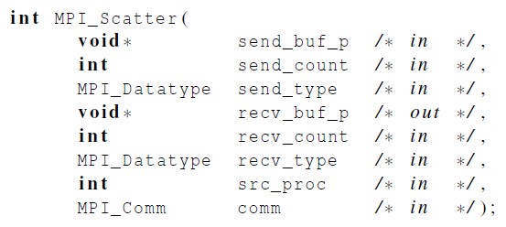
Scatter
MPI_Scatter can be used in a function that reads in an entire vector on process 0 but only sends the needed components to each of the other processes.

Slide 36
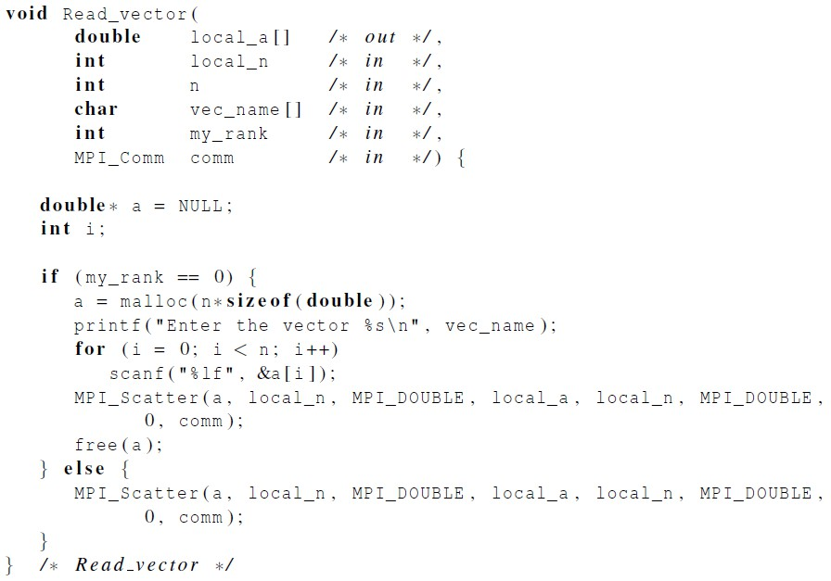
Reading and distributing a vector

Slide 37
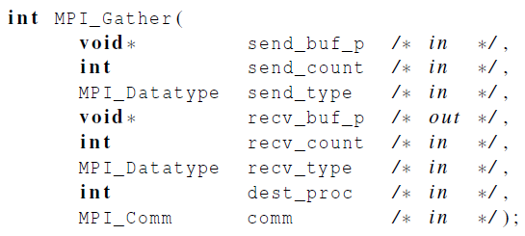
Gather
Collect all of the components of the vector onto process 0, and then process 0 can process all of the components.

Slide 38
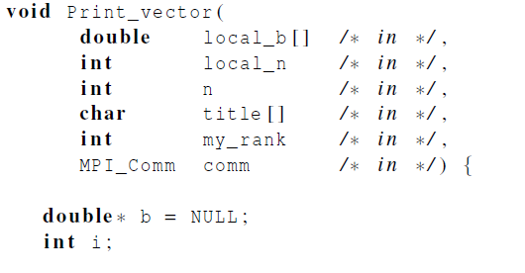
Print a distributed vector (1)

Slide 39
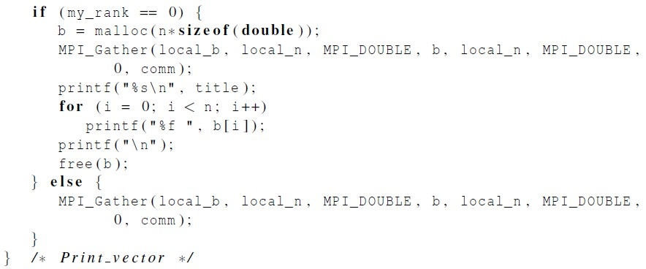
Print a distributed vector (2)

Slide 40
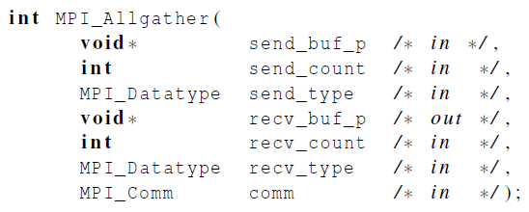
Allgather
Concatenates the contents of each process’ send_buf_p and stores this in each process’ recv_buf_p.
As usual, recv_count is the amount of data being received from each process.

Slide 41
Matrix-vector multiplication
i-th component of y
Dot product of the ith
row of A with x.

Slide 42
Safety in MPI programs
The MPI standard allows MPI_Send to behave in two different ways:
it can simply copy the message into an MPI managed buffer and return,
or it can block until the matching call to MPI_Recv starts.

Slide 43
Safety in MPI programs
Many implementations of MPI set a threshold at which the system switches
from buffering to blocking.
Relatively small messages will be buffered by MPI_Send.
Larger messages, will cause it to block.

Slide 44
Safety in MPI programs
If the MPI_Send executed by each process blocks, no process will be able to start executing a call to MPI_Recv, and the program will hang or deadlock.
Each process is blocked waiting for an event that will never happen.
(see pseudo-code)

Slide 45
Safety in MPI programs
A program that relies on MPI provided buffering is said to be unsafe.
Such a program may run without problems for various sets of input, but it may hang or crash with other sets.

Slide 46
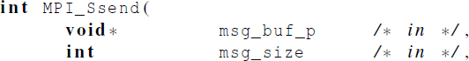
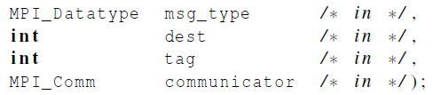
MPI_Ssend
An alternative to MPI_Send defined by the MPI standard.
The extra “s” stands for synchronous and MPI_Ssend is guaranteed to
block until the matching receive starts.

Slide 47
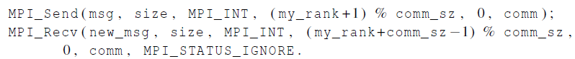

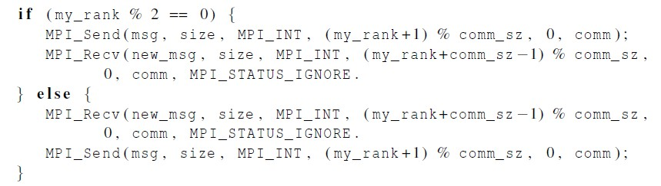
Restructuring communication

Slide 48
MPI_Sendrecv
An alternative to scheduling the communications ourselves.
Carries out a blocking send and a receive in a single call.
The dest and the source can be the same or different.
Especially useful because MPI schedules the communications so that the program won’t hang or crash.

Slide 49
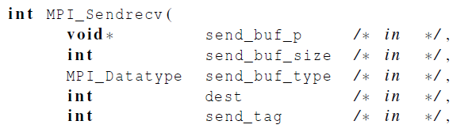
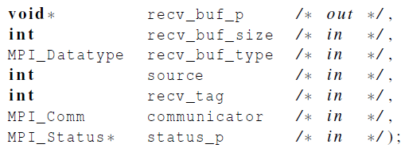
MPI_Sendrecv

Slide 50


















Safe communication with five processes

Slide 51
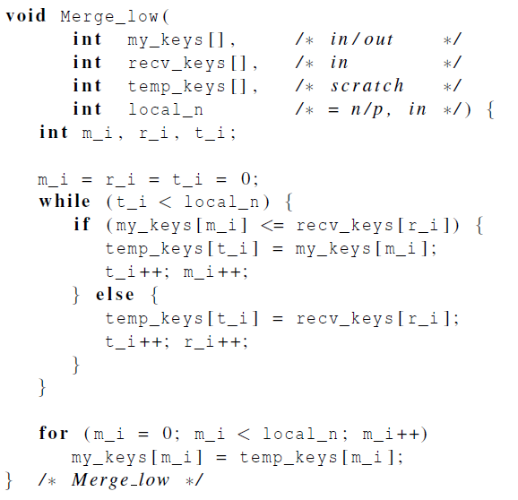
Parallel odd-even transposition sort
https://github.com/sachugowda/pds-bits/blob/main/add-even.md

Slide 52
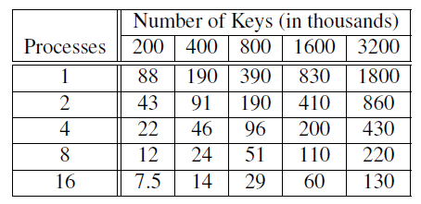
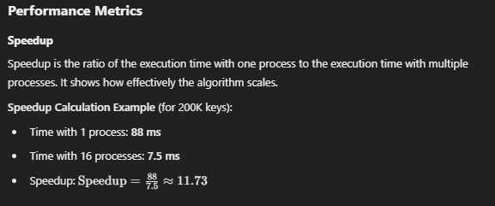
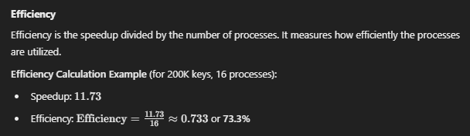
Run-times of parallel odd-even sort
(times are in milliseconds)

Slide 53
Thank You
Extra slides follows

Slide 54
Outline
Writing your first MPI program.
Using the common MPI functions.
Collective communication.
MPI derived datatypes.
Performance evaluation of MPI programs.
Parallel sorting.
Safety in MPI programs.

Slide 55
A distributed memory system

Slide 56
A shared memory system

Slide 57
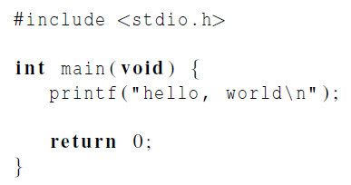

Hello World!
(a classic)

Slide 58
Identifying MPI processes
Common practice to identify processes by nonnegative integer ranks.
p processes are numbered 0, 1, 2, .. p-1

Slide 59

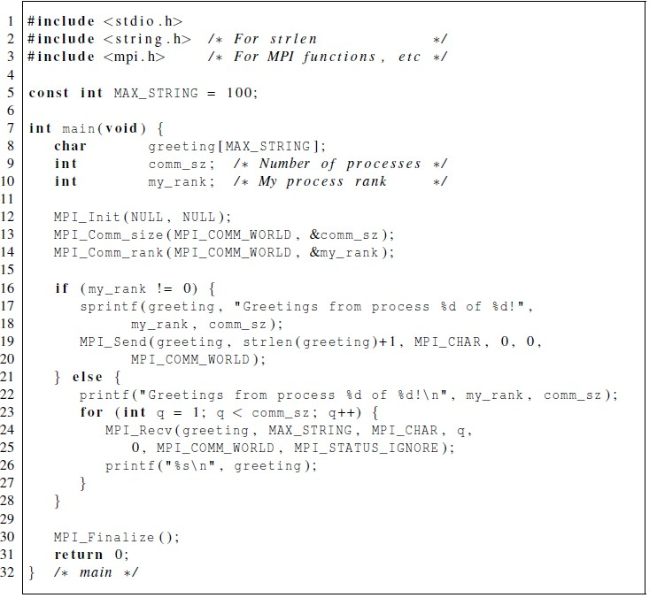
Our first MPI program

Slide 60
Compilation
wrapper script to compile
source file
mpicc -g -Wall -o mpi_hello mpi_hello.c
produce debugging
information
create this executable file name (as opposed to default a.out)
turns on all warnings

Slide 61
Execution
mpiexec -n <number of processes>
<executable>
mpiexec -n 1 ./mpi_hello
run with 1 process
mpiexec -n 4 ./mpi_hello
run with 4 processes

Slide 62
Execution
mpiexec -n 1 ./mpi_hello
Greetings from process 0 of 1 !
mpiexec -n 4 ./mpi_hello
Greetings from process 0 of 4 ! Greetings from process 1 of 4 ! Greetings from process 2 of 4 ! Greetings from process 3 of 4 !

Slide 63
MPI Programs
Written in C.
Has main.
Uses stdio.h, string.h, etc.
Need to add mpi.h header file.
Identifiers defined by MPI start with “MPI_”.
First letter following underscore is uppercase.
For function names and MPI-defined types.
Helps to avoid confusion.

Slide 64
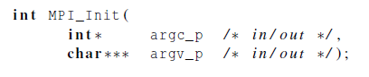
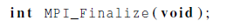
MPI Components
MPI_Init
Tells MPI to do all the necessary setup.
MPI_Finalize
Tells MPI we’re done, so clean up anything allocated for this program.

Slide 65
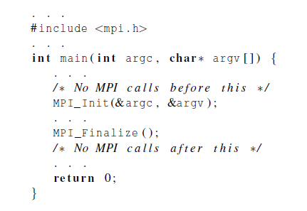
Basic Outline

Slide 66
Communicators
A collection of processes that can send messages to each other.
MPI_Init defines a communicator that consists of all the processes created
when the program is started.
Called MPI_COMM_WORLD.

Slide 67

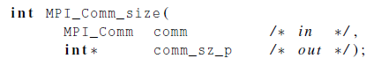
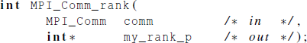
Communicators
number of processes in the communicator
my rank
(the process making this call)

Slide 68
SPMD
Single-Program Multiple-Data
We compile one program.
Process 0 does something different.
Receives messages and prints them while the other processes do the work.
The if-else construct makes our program SPMD.

Slide 69
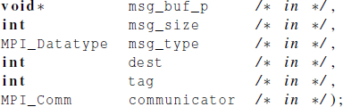

Communication

Slide 70
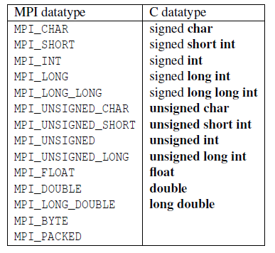
Data types

Slide 71
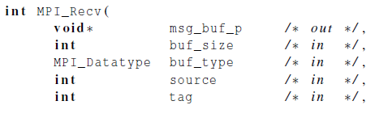
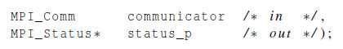
Communication

Slide 72

Message matching
r
MPI_Send
src = q
MPI_Recv
dest = r
q

Slide 73

Receiving messages
A receiver can get a message without knowing:
the amount of data in the message,
the sender of the message,
or the tag of the message.

Slide 74
status_p argument
MPI_Status*
MPI_Status* status;
status.MPI_SOURCE status.MPI_TAG
MPI_SOURCE MPI_TAG MPI_ERROR

Slide 75
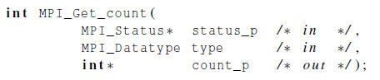

How much data am I receiving?

Slide 76

Issues with send and receive
Exact behavior is determined by the MPI implementation.
MPI_Send may behave differently with regard to buffer size, cutoffs and
blocking.
MPI_Recv always blocks until a matching message is received.
Know your implementation;
don’t make assumptions!

Slide 77
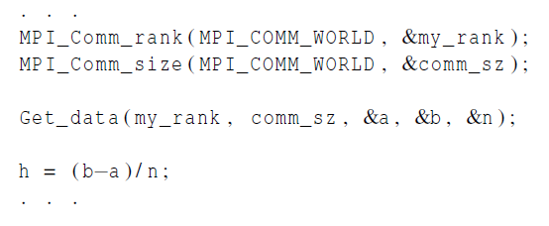
Input
Most MPI implementations only allow process 0 in MPI_COMM_WORLD access to stdin.
Process 0 must read the data (scanf) and send to the other processes.

Slide 78
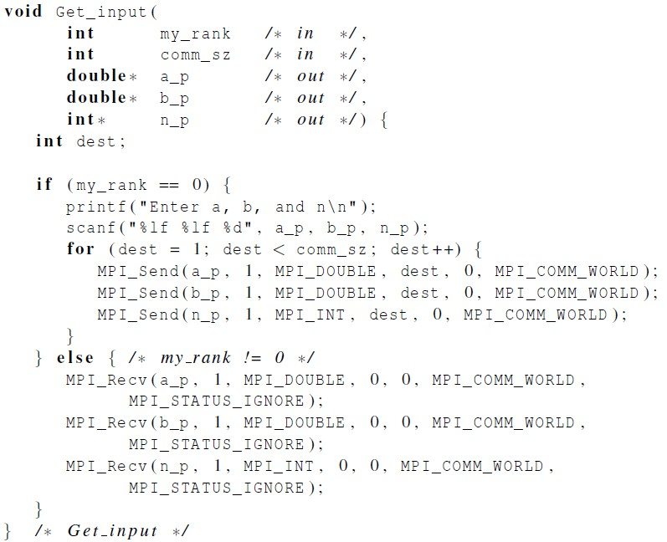
Function for reading user input

Slide 79

Collective communication

Slide 80
Tree-structured communication
In the first phase:
Process 1 sends to 0, 3 sends to 2, 5 sends to 4, and 7 sends to 6.
Processes 0, 2, 4, and 6 add in the received values.
Processes 2 and 6 send their new values to processes 0 and 4, respectively.
Processes 0 and 4 add the received values into their new values.
(a) Process 4 sends its newest value to process 0.
(b) Process 0 adds the received value to its newest value.

Slide 81

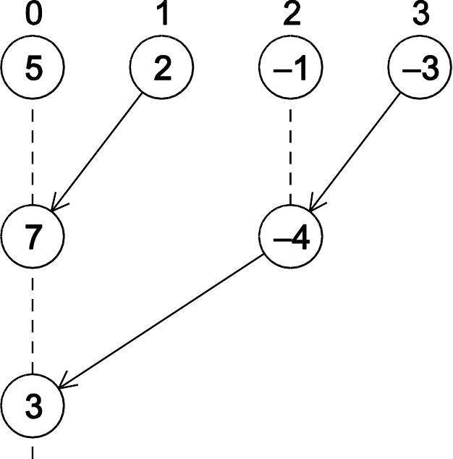
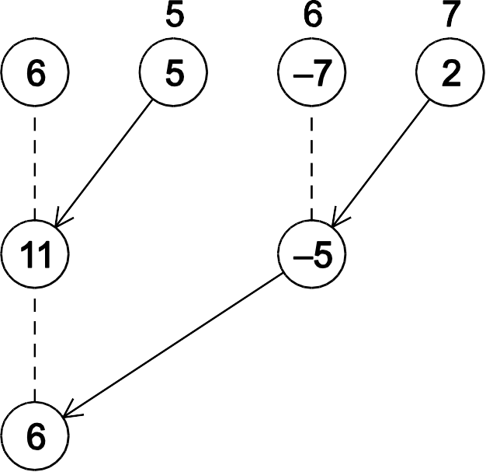

A tree-structured global sum

Slide 82










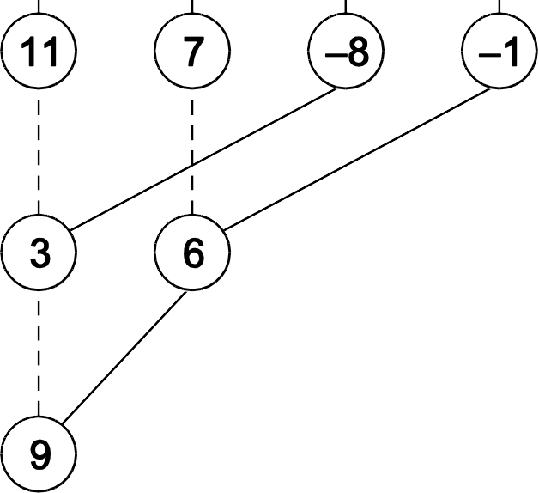
An alternative tree-structured global sum

Slide 83
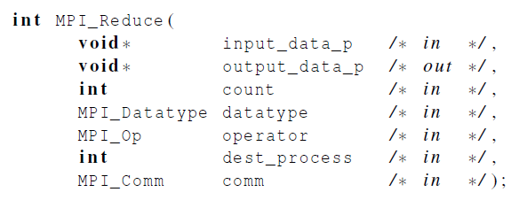
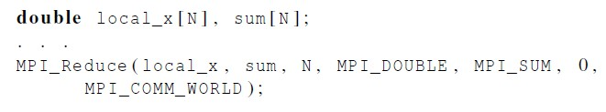
MPI_Reduce

Slide 84
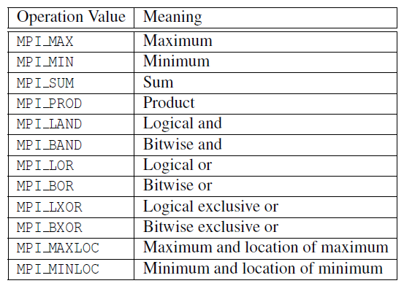
Predefined reduction operators in MPI

Slide 85
Collective vs. Point-to-Point Communications
All the processes in the communicator must call the same collective function.
For example, a program that attempts to match a call to MPI_Reduce on one process with a call to MPI_Recv on another process is erroneous, and, in all likelihood, the program will hang or crash.

Slide 86
Collective vs. Point-to-Point Communications
The arguments passed by each process to an MPI collective communication must be “compatible.”
For example, if one process passes in 0 as the dest_process and another passes in 1, then the outcome of a call to MPI_Reduce is erroneous, and, once again, the program is likely to hang or crash.

Slide 87
Collective vs. Point-to-Point Communications
The output_data_p argument is only used on dest_process.
However, all of the processes still need to pass in an actual argument corresponding to output_data_p, even if it’s just NULL.

Slide 88
Collective vs. Point-to-Point Communications
Point-to-point communications are matched on the basis of tags and communicators.
Collective communications don’t use tags.
They’re matched solely on the basis of the communicator and the order in which they’re called.

Slide 89
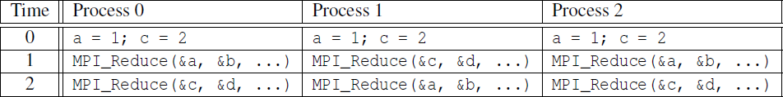
Example (1)
Multiple calls to MPI_Reduce

Slide 90
Example (2)
Suppose that each process calls MPI_Reduce with operator MPI_SUM, and destination process 0.
At first glance, it might seem that after the two calls to MPI_Reduce, the value of b will be 3, and the value of d will be 6.

Slide 91
Example (3)
However, the names of the memory locations are irrelevant to the matching of the calls to MPI_Reduce.
The order of the calls will determine the matching so the value stored in b will be 1+2+1 = 4, and the value stored in d will be 2+1+2 = 5.

Slide 92

MPI_Allreduce
Useful in a situation in which all of the processes need the result of a global sum in order to complete some larger computation.

Slide 93





















A global sum followed by distribution of the result.

Slide 94

A butterfly-structured global sum.

Slide 95

Broadcast
Data belonging to a single process is sent to all of the processes in the communicator.

Slide 96















A tree-structured broadcast.

Slide 97

A version of Get_input that uses MPI_Bcast

Slide 98
Data distributions
Compute a vector sum.

Slide 99
Serial implementation of vector addition

Slide 100
Different partitions of a 12-component vector among 3
processes

Slide 101
Partitioning options
Block partitioning
Assign blocks of consecutive components to each process.
Cyclic partitioning
Assign components in a round robin fashion.
Block-cyclic partitioning
Use a cyclic distribution of blocks of components.

Slide 102
Parallel implementation of vector addition

Slide 103
Scatter
MPI_Scatter can be used in a function that reads in an entire vector on process 0 but only sends the needed components to each of the other processes.

Slide 104
Reading and distributing a vector

Slide 105
Gather
Collect all of the components of the vector onto process 0, and then process 0 can process all of the components.

Slide 106
Print a distributed vector (1)

Slide 107
Print a distributed vector (2)

Slide 108
Allgather
Concatenates the contents of each process’ send_buf_p and stores this in each process’ recv_buf_p.
As usual, recv_count is the amount of data being received from each process.

Slide 109
Matrix-vector multiplication
i-th component of y
Dot product of the ith
row of A with x.

Slide 110

Matrix-vector multiplication

Slide 111


Multiply a matrix by a vector
Serial pseudo-code

Slide 112


C style arrays
stored as

Slide 113

Serial matrix-vector multiplication

Slide 114

An MPI matrix-vector multiplication function (1)

Slide 115

An MPI matrix-vector multiplication function (2)

Slide 116

Mpi derived datatypes

Slide 117
Derived datatypes
Used to represent any collection of data items in memory by storing both the types of the items and their relative locations in memory.
The idea is that if a function that sends data knows this information about a collection of data items, it can collect the items from memory before they are sent.
Similarly, a function that receives data can distribute the items into their correct destinations in memory when they’re received.

Slide 118

Derived datatypes
Formally, consists of a sequence of basic MPI data types together with a displacement for each of the data types.
Trapezoidal Rule example:

Slide 119

MPI_Type create_struct
Builds a derived datatype that consists of individual elements that have different basic types.

Slide 120

MPI_Get_address
Returns the address of the memory location referenced by location_p.
The special type MPI_Aint is an integer type that is big enough to store an
address on the system.

Slide 121
MPI_Type_commit
Allows the MPI implementation to optimize its internal representation of the datatype for use in communication functions.

Slide 122
MPI_Type_free
When we’re finished with our new type, this frees any additional storage used.

Slide 123

Get input function with a derived datatype (1)

Slide 124

Get input function with a derived datatype (2)

Slide 125

Get input function with a derived datatype (3)

Slide 126

Performance evaluation

Slide 127

Elapsed parallel time
Returns the number of seconds that have elapsed since some time in the past.

Slide 128


Elapsed serial time
In this case, you don’t need to link in the MPI libraries.
Returns time in microseconds elapsed from some point in the past.

Slide 129

Elapsed serial time

Slide 130

MPI_Barrier
Ensures that no process will return from calling it until every process in the communicator has started calling it.

Slide 131


MPI_Barrier

Slide 132

Run-times of serial and parallel matrix-vector multiplication
(Seconds)

Slide 133

Speedup

Slide 134

Efficiency

Slide 135

Speedups of Parallel Matrix-Vector Multiplication

Slide 136

Efficiencies of Parallel Matrix-Vector Multiplication

Slide 137

Scalability
A program is scalable if the problem size can be increased at a rate so that the efficiency doesn’t decrease as the number of processes increase.

Slide 138
Scalability
Programs that can maintain a constant efficiency without increasing the problem size are sometimes said to be strongly scalable.
Programs that can maintain a constant efficiency if the problem size increases at the same rate as the number of processes are sometimes said to be weakly scalable.

Slide 139
A parallel sorting algorithm

Slide 140
Sorting
n keys and p = comm sz processes.
n/p keys assigned to each process.
No restrictions on which keys are assigned to which processes.
When the algorithm terminates:
The keys assigned to each process should be sorted in (say) increasing order.
If 0 ≤ q < r < p, then each key assigned to process q should be less than or equal to every key assigned to process r.

Slide 141


Serial bubble sort

Slide 142
Odd-even transposition sort
A sequence of phases.
Even phases, compare swaps:
Odd phases, compare swaps:

Slide 143
Example
Start: 5, 9, 4, 3
Even phase: compare-swap (5,9) and (4,3)
getting the list 5, 9, 3, 4
Odd phase: compare-swap (9,3) getting the list 5, 3, 9, 4
Even phase: compare-swap (5,3) and (9,4)
getting the list 3, 5, 4, 9
Odd phase: compare-swap (5,4)
getting the list 3, 4, 5, 9

Slide 144

Serial odd-even transposition sort

Slide 145


Communications among tasks in odd-even sort
Tasks determining a[i] are labeled with a[i].

Slide 146

Parallel odd-even transposition sort

Slide 147

Pseudo-code

Slide 148

Compute_partner

Slide 149
Safety in MPI programs
The MPI standard allows MPI_Send to behave in two different ways:
it can simply copy the message into an MPI managed buffer and return,
or it can block until the matching call to MPI_Recv starts.

Slide 150
Safety in MPI programs
Many implementations of MPI set a threshold at which the system switches
from buffering to blocking.
Relatively small messages will be buffered by MPI_Send.
Larger messages, will cause it to block.

Slide 151
Safety in MPI programs
If the MPI_Send executed by each process blocks, no process will be able to start executing a call to MPI_Recv, and the program will hang or deadlock.
Each process is blocked waiting for an event that will never happen.
(see pseudo-code)

Slide 152
Safety in MPI programs
A program that relies on MPI provided buffering is said to be unsafe.
Such a program may run without problems for various sets of input, but it may hang or crash with other sets.

Slide 153
MPI_Ssend
An alternative to MPI_Send defined by the MPI standard.
The extra “s” stands for synchronous and MPI_Ssend is guaranteed to
block until the matching receive starts.

Slide 154
Restructuring communication

Slide 155
MPI_Sendrecv
An alternative to scheduling the communications ourselves.
Carries out a blocking send and a receive in a single call.
The dest and the source can be the same or different.
Especially useful because MPI schedules the communications so that the program won’t hang or crash.

Slide 156
MPI_Sendrecv

Slide 157
Safe communication with five processes

Slide 158
Parallel odd-even transposition sort

Slide 159
Run-times of parallel odd-even sort
(times are in milliseconds)

Slide 160
Concluding Remarks (1)
MPI or the Message-Passing Interface is a library of functions that can be
called from C, C++, or Fortran programs.
A communicator is a collection of processes that can send messages to each other.
Many parallel programs use the single-program multiple data or SPMD approach.

Slide 161
Concluding Remarks (2)
Most serial programs are deterministic: if we run the same program with
the same input we’ll get the same output.
Parallel programs often don’t possess this property.
Collective communications involve all the processes in a communicator.

Slide 162
Concluding Remarks (3)
When we time parallel programs, we’re usually interested in elapsed time
or “wall clock time”.
Speedup is the ratio of the serial run-time to the parallel run-time.
Efficiency is the speedup divided by the number of parallel processes.

Slide 163
Concluding Remarks (4)
If it’s possible to increase the problem size (n) so that the efficiency doesn’t decrease as p is increased, a parallel program is said to be scalable.
An MPI program is unsafe if its correct behavior depends on the fact that MPI_Send is buffering its input.

